Slide 1
MAITRI: AN AI ASSISTANT FOR PSYCHOLOGICAL & PHYSICAL WELL-BEING OF ASTRONAUTS
CSE7302- University Project
Review-3
Batch Number: CSE_65
Under the Supervision of,
Dr. Balakrishnan Raju
Associate Professor
School of Computer Science and Engineering
Presidency University
Roll Number | Student Name
20221CSE0484 | K SAI SRI
20221CSE0446 | MEGHANA K
Name of the Program: B.Tech, Computer Science and Engineering
Name of the HoD: Dr. Blessed Prince
Name of the Program Project Coordinator: DR. MUTHURAJU V
Name of the School Project Coordinators: Dr. Sampath A K , Dr. Geetha A

Slide 2
Content
Problem Statement
Abstract
Background and Related work
Objectives
Existing Methods and Drawbacks
Proposed Method & Feasibility Study
Architecture Diagram
Modules
Hardware and Software Details
Analysis of Problem Statement
Innovation or Novel Contributions
Timeline of the Project
References

Slide 3
Problem Statement
Problem Statement Number: SIH25175
Organization: Indian Space Research Organisation(ISRO)
Category: Software
Problem Description: MAITRI: An AI Assistant for Psychological & Physical Well-Being of Astronauts
Long-duration space missions expose astronauts to stress, isolation, and fatigue, while delayed communication with Earth limits continuous support, creating the need for an autonomous AI-based well-being assistance system.

Slide 4
Abstract
Mental well-being is a critical challenge for individuals working in isolated, high-stress environments such as space missions. Prolonged confinement, limited social interaction, and communication delays can lead to psychological strain, making continuous emotional support essential. This project, MAITRI, aims to provide an intelligent mental-health companion capable of understanding a user's emotional state and offering timely, personalized support.
MAITRI uses a combination of Natural Language Processing (NLP) and rule-based analysis to interpret user inputs, detect emotions, assess stress levels, and provide suitable recommendations. The system architecture includes a React-based frontend for seamless interaction, a FastAPI backend for processing user queries, an NLP engine for sentiment and emotion analysis, and an optional database layer for storing conversation history and emotional patterns.
By offering a simple, accessible, and always-available support system, MAITRI enhances physiological and physical well-being, improves self-awareness, and contributes to healthier decision-making. The solution is lightweight, feasible to implement, and scalable for use in both everyday scenarios and mission-critical environments like space travel.

Slide 5
Background and Related work
AUTHOR | YEAR | TITLE | METHODOLOGY | INFERENCE
Annahita Nezami | 2025 | Space Psychology: A Comprehensive Approach to the Future of Astronaut Well-Being | Review and analytical method based on existing research, theories, and literature | A combined approach of psychology and technology is essential for future space missions
Sardar Ali Shah, Saba Karim, Ramesh Kumar, Amir Latif Bhatti | 2024 | Beyond the Gravity: Exploring Legal Position of Astronauts’ Well-Being in Space | Doctrinal research method analyzing space laws, international treaties, and regulations | Existing space laws need improvement to better protect astronauts
Ivan A. Rozanov | 2022 | Psychological Support for Astronauts in Space | Use of Virtual Reality (VR); data collected through observations, questionnaires, and sleep monitoring | Psychological support methods can be extended to hospitals and general medical care
Francesco Pagnini, Francesca Grosso | 2025 | Human Space Exploration: Benefits to Humanity | Analysis of existing research studies and space psychology literature | Astronauts experience stress and mental health challenges during long-duration missions
Yi Wang, Delong Dong, Wenlian Zhou | 2025 | Wearable Health Monitoring for Astronauts | Study of current wearable technologies and flexible wearable device applications in space | Wearable devices enhance astronaut safety, though technical challenges still remain

Slide 6
Background and Related work(contd...)
AUTHOR | YEAR | TITLE | METHODOLOGY | INFERENCE
Nathan Smith | 2023 | Technology to Support Mental Health in Deep Space | Analysis of digital health technologies combined with psychological and human-factor theories | Digital tools such as VR, AI assistants, monitoring systems, and automated support can effectively aid astronaut mental health
Antonia Russo, Gianluca Lax | 2022 | Using Artificial Intelligence for Space Challenges | Application of Machine Learning, Deep Learning, Reinforcement Learning, and NLP | Provides strong justification for systems like MAITRI that integrate mental health monitoring with decision support
Mario A. Cypko, Ulrich Straube, Russell J. Andrews, Oliver Amft | 2025 | Digital Health for Space: Towards Prevention, Training, Empowerment, and Autonomy | Evaluation across space mission scenarios (ISS, Moon, Mars, deep space) | Long-duration space missions require autonomous digital health systems
Brenda K. Wiederhold | 2025 | From Cyberspace to Outer Space | Discussion of existing and emerging digital technologies | Astronauts face significant mental health challenges due to isolation, stress, and extended missions
Donald D. Chang | 2020 | Promoting Tech Transfer Between Space and Global Mental Health | Space medicine research using a systematic review method | AI, mobile apps, sensors, telemedicine, and chatbots can effectively support mental health care

Slide 7
Objectives
To develop an AI-powered assistant that supports the psychological and physical well-being of astronauts during long-duration space missions.
To provide a conversational interaction mechanism that allows astronauts to naturally express stress, fatigue, and daily experiences, and to analyze these interactions to detect emotional and stress levels.
To monitor overall well-being trends by integrating emotional indicators with simulated physical parameters such as sleep quality and fatigue levels.
To generate a well-being risk score and adaptive support strategies, including relaxation activities and routine guidance, for early identification and mitigation of mental or physical strain.
To design and evaluate a privacy-aware, offline-capable web-based system, including a dashboard for visualizing well-being status, trends, and recommendations using simulated mission scenarios.

Slide 8
Existing Methods and Drawbacks
Research Paper & Author(s) | Existing Model / Method | Summary of Approach | Limitations | Critique
Space Psychology: A Comprehensive Approach to the Future of Astronaut Well-Being - Annahita Nezami (2025) | Review-based psychological and technological framework | Reviews psychological and technological approaches for supporting astronaut mental health | Based entirely on existing literature; lacks experimental or system-level validation. | The approach is conceptual and does not propose a concrete implementation or autonomous support system.
Beyond the Gravity: Exploring Legal Position of Astronauts’ Well-Being in Space - Sardar Ali Shah (2024) | Doctrinal legal research model | Analyzes international space laws, treaties, and regulations related to astronaut well-being. | Addresses legal aspects only, without psychological or technological support. | Provides policy insight but offers no practical solution for real-time mental health monitoring or support.
Psychological Support for Astronauts in Space - Ivan A. (2022) | VR-based psychological support and monitoring system | Uses Virtual Reality, questionnaires, and sleep monitoring | Requires advanced hardware, continuous monitoring, resources | Scalability and feasibility are limited for long-duration.
Human Space Exploration: Benefits to Humanity -Francesco Pagnini, Francesca Grosso (2025) | Space psychology analytical framework | Reviews psychological challenges such as stress and mental strain during long-duration space missions. | Mainly descriptive and analytical; lacks intervention or support mechanisms. | Does not integrate digital or AI-based solutions for proactive mental health management.
Wearable Health Monitoring for Astronauts - Yi Wang, Delong Dong, Wenjian Zhou (2025) | Wearable sensor-based health monitoring model | Studies wearable devices for continuous physiological monitoring of astronauts in space. | Focuses primarily on physical health indicators. | Mental health assessment remains indirect and insufficient for comprehensive psychological evaluation.

Slide 9
Existing Methods and Drawbacks(contd...)
Research Paper & Author(s) | Existing Model / Method | Summary of Approach | Limitations | Critique
Mental Health Technologies for Space Missions - Smith (2023) | Digital mental health framework | Uses VR and AI tools to support astronaut mental health. | Depends on Earth-based support. | Limited autonomy in deep-space missions.
Artificial Intelligence and Machine Learning in Space Systems - Russo & Lax (2022) | AI and ML-based intelligent systems | Applies machine learning, and NLP techniques for decision support | Requires large datasets and extensive training. | Reliability and ethical concerns limit direct use in mental health decision-making.
Autonomous Digital Health Systems for Space Missions - Cypko et al. (2025) | Autonomous digital health and self-management systems | Focuses on prevention, training, and autonomous health | High system complexity and integration challenges. | Strong dependence on system accuracy poses risks in critical environments.
Emerging Digital Technologies for Mental Health in Space - Wiederhold (2025) | Digital and immersive technology framework | Reviews emerging digital and cyberspace technologies to address in space. | Mostly theoretical with limited empirical evaluation. | Lack of astronaut-centered validation reduces practical applicability.
Technology Transfer from Space to Earth for Mental Health Care - Chang (2020) | AI, telemedicine, and mobile health model | Explores AI, sensors, telemedicine, mobile apps, and chatbots for mental health support. | Generalized solutions not tailored for deep-space missions. | Does not fully address isolation, latency, and autonomy constraints in space.

Slide 10
Proposed Method & Feasibility Study
PROPOSED METHOD
1. User Interaction
User enters their emotional text/query through the React-based chat interface.
The interface sends the message to the backend using REST API.
2. NLP-Based Text Processing
FastAPI backend receives the message.
Text is cleaned, tokenized, and processed using NLP techniques.
Sentiment and emotional tone (stress, sadness, anxiety) are identified.
3. Risk Assessment
The analyzed sentiment score is passed into a rule-based engine.
The system categorizes the emotional intensity into:
Low risk
Moderate risk
High risk

Slide 11
Proposed Method & Feasibility Study(contd...)
4. Suggestion Generation
Based on emotional category, the Suggestion Engine provides:
Coping strategies
Relaxation/breathing techniques
Positive reinforcement
Emergency help message (if risk is high)
5. Response Delivery
The backend sends the final structured response back to the React UI.
The user sees:
System-generated support message
Suggested activities/techniques
Emotional insights
6. Optional Logging
Conversation history and sentiment scores may be stored in the SQLite database for future analysis.

Slide 12
Proposed Method & Feasibility Study(contd...)
FEASIBILITY STUDY
1. Technical Feasibility
Frontend: React + Tailwind - widely supported, easy to develop, fast.
Backend: FastAPI - lightweight, high-performance Python framework.
NLP Models: Uses simple sentiment analysis and rule-based logic - no heavy GPU required.
Database: SQLite - lightweight, file-based, easy to integrate.
Hosting: Can run on any cloud platform (Render, Railway, Azure). - Conclusion: All required tools are open-source and beginner-friendly, making technical implementation fully feasible.
2. Operational Feasibility
Users can easily interact with the chatbot-style UI.
No complicated onboarding or training required.
MAITRI provides instant emotional support, which improves the likelihood of regular usage. - Conclusion: The system is simple to use, making operational feasibility high.
3. Economic Feasibility
Uses open-source tools (React, FastAPI, Python, Tailwind).
No paid APIs or external services required for baseline functionality.
Hosting cost is minimal - can be deployed on free/low-cost cloud tiers. - Conclusion: Cost of development and maintenance is extremely low → economically feasible.

Slide 13
Proposed Method & Feasibility Study(contd...)
4. Schedule Feasibility
The project modules can be completed within the academic timeline:
Conclusion: The project can be fully completed before final review.
5. Future Feasibility
Can scale with more features:
Deep-learning based sentiment models
Cloud deployment
Voice input
Personalized insights
Conclusion: High potential for future expansion.
PHASE | TIMELINE | STATUS
Frontend UI | 1-2 weeks | Started
Backend setup | 1 week | Done
NLP + Risk Engine | 1-2 weeks | Pending
Integration & Testing | 1 week | Pending

Slide 14
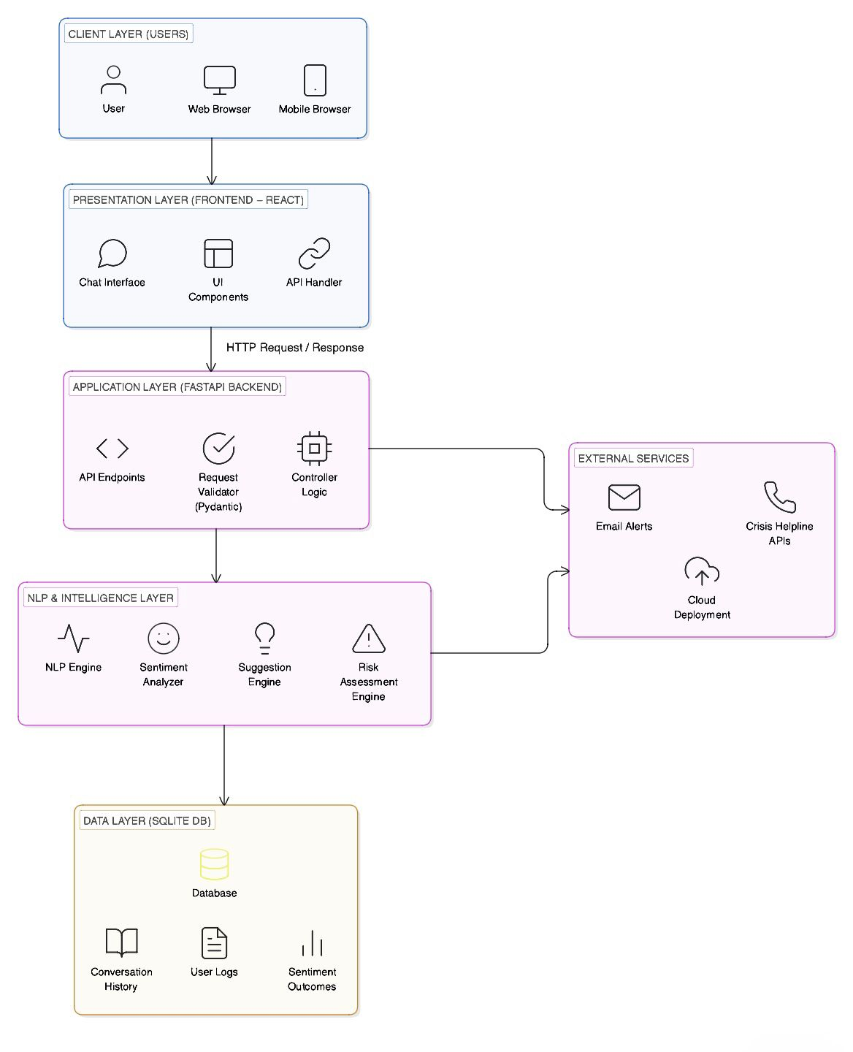
Architecture Diagram
MAITRI – System Architecture

Slide 15
Modules
User Authentication Module
User Registration
User Login
Password reset
Secure token-based session handling
Mood Tracking Module
Daily mood input (emoji/text)
Store mood history
View past trends
AI Mental Health Assistant Module
Chat interface
AI-generated responses
Context-based conversation
Emotion-aware feedback
Journal & Notes Module
Add personal journal entries
Edit / Delete entries
View journal history

Slide 16
Modules(contd...)
Crisis Support Module
SOS helplines
Emergency contact list
Quick-access support resources
Personalized Recommendation Module
Mental wellness tips
Breathing exercises
Quotes / Affirmations
Recommendations based on mood patterns
Notification & Reminder Module
Daily mood check-in reminder
Journaling reminder
Wellness practice reminder
Admin Dashboard
View system usage
Manage user feedback
Basic analytics

Slide 17
Hardware and Software Details
HARDWARE REQUIREMENTS
Processor: Intel Core i5
RAM: 8 GB
Storage: 20–30 GB free space
Operating System: Windows 10/11, macOS, or Ubuntu Linux
Display: 1080p resolution
SOFTWARE REQUIREMENTS
Frontend Technologies
React.js – User interface development
Tailwind CSS / CSS – Styling
JavaScript (ES6+)
npm / Node.js – Dependency management

Slide 18
Hardware and Software Details(contd...)
Backend Technologies
Python 3.10+
FastAPI – RESTful backend framework
Uvicorn – ASGI server
Pydantic – Request validation
Postman – API testing
NLP & AI Components
SpaCy – Text preprocessing
VADER – Sentiment analysis
Custom Rule-based Engine – Stress & risk evaluation
Suggestion Engine – Mental health tips & coping strategies

Slide 19
Hardware and Software Details(contd...)
Database
SQLite Database
Stores conversation history
Stores user logs
Stores sentiment/risk scores
SQLAlchemy – ORM layer
DEVELOPMENT TOOLS
VS Code / PyCharm – Code editors
Git & GitHub – Version control
Browser: Chrome / Firefox
Swagger UI – Auto-generated docs from FastAPI
pytest – Testing & debugging

Slide 20
Algorithms Used
1. VADER (Valence Aware Dictionary and sEntiment Reasoner)
Sentiment analysis on text
Produces compound score in [-1, 1] and labels (positive / neutral / negative)
Used in nlp.py
2. spaCy NLP pipeline
Tokenization, lemmatization, stopword filtering
Uses en_core_web_sm for preprocessing
Used in nlp.py
3. Rule-based stress score
Combines sentiment, fatigue, and sleep quality
Formula: sentiment_component + fatigue_component + sleep_component (with fixed weights)
Used in risk_engine.py
4. Risk level thresholds
Maps a 0–100 risk score to levels: low (<30), moderate (30–60), high (60–80), critical (≥80)
Used in risk_engine.py
5. Sleep duration penalty
Adds penalty for low sleep hours (<4, <6, <7)
Used in risk_engine.py

Slide 21
Algorithms Used(contd...)
6. Crisis detection
Rule-based: critical risk, or high risk with score ≥75, or sentiment ≤ -0.6 with risk ≥60
Used in risk_engine.py
7. Issue severity ranking
Computes severity for sleep, fatigue, mood
Ranks primary and secondary issues
Used in suggestion_engine.py
8. Input-sensitive seed
Hash-like seed from sentiment, fatigue, sleep quality, hours slept
Drives suggestion variety
Used in suggestion_engine.py
9. Deterministic suggestion selection
Uses seed and step-based indexing to pick suggestions from pools
Avoids repeats and keeps variety
Used in suggestion_engine.py
10. Adaptive suggestion logic
Uses recent history (fatigue, sleep quality, risk scores)
Thresholds: avg fatigue ≥6, avg sleep quality <5, avg risk ≥55
Adds personalized tips
Used in suggestion_engine.py

Slide 22
Algorithms Used(contd...)
11. Peak stress prediction
Filters entries with risk_score ≥ 70
Creates 6-hour windows around high-risk points
Severity: high (≥80) vs moderate (70–80)
Used in routers/wellness.py (/timeline)
12. Circadian misalignment score
Heuristic: (10 - avg_sleep_quality) * 5 + max(0, 7 - avg_hours) * 5
Produces 0–100 score from recent sleep data
Used in routers/wellness.py (/sleep-prediction)
13. Trend aggregation
Time-windowed aggregation of risk, fatigue, sleep, sentiment
Used in routers/wellness.py (/trend)

Slide 23
Analysis of Problem Statement
Astronauts who stay in space for a long time face mental and physical challenges due to isolation, confinement, and heavy work pressure.
Problems such as stress, tiredness, poor sleep, and reduced concentration usually develop slowly and are hard to notice in the early stages.
At present, astronauts mainly depend on scheduled communication with Earth and basic health monitoring for support.
In deep space missions, communication delays make it difficult to receive continuous psychological support from Earth.
Existing systems focus mostly on physical health or mission tasks and do not provide continuous emotional or mental well-being support.
Hence, there is a need for an AI-based system that can continuously monitor well-being, identify early warning signs, and provide supportive guidance during long-duration space missions.

Slide 24
Innovation or Novel Contributions
Our system is unique because it:
Brings psychological and physical well-being support into one platform – conversation, stress understanding, risk monitoring, and guidance are all combined in a single system.
Allows astronauts to express their feelings naturally – through a simple chat interface without pressure or judgement.
Understands stress and emotional patterns over time – instead of reacting to a single message, it tracks changes across days.
Provides personalized and adaptive support – suggestions and responses change based on the astronaut’s condition and past interactions.
Identifies early warning signs – a well-being risk score helps detect mental or physical strain before it becomes serious.
Works in low-connectivity or offline environments – ensuring continuous support even when communication with Earth is delayed.
Respects privacy and ethical boundaries – offers support without medical diagnosis or sharing personal data.

Slide 25
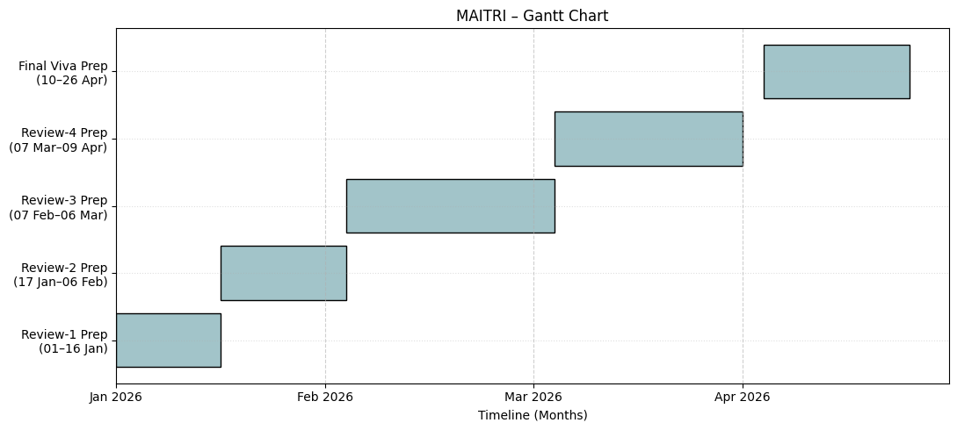
Timeline of the Project (Gantt Chart)

Slide 26
References (IEEE Paper format)
[1] D. D. Chang, E. A. Storch, L. Black, M. Berk, N. Pellis, H. Lavretsky, J. Sutton, K. Ternes, M. Shepanek, E. Smith, R. Abbott, and H. A. Eyre, “Promoting tech transfer between space and global mental health,” Aerospace Medicine and Human Performance, vol. 91, no. 9, pp. 737–745, Sep. 2020.
[2] S. L. Chandra, P. R. Nair, and R. Kumar, “Artificial intelligence–based mental health support systems: A review,” arXiv preprint arXiv:2105.03216, May 2021.
[3] J. R. Clément and R. S. Ngo-Anh, “Keeping astronauts healthy during long-duration space missions,” Acta Astronautica, vol. 126, pp. 168–176, Sep. 2016.
[4] M. A. Cypko, U. Straube, R. J. Andrews, and O. Amft, “Digital health for space: Towards prevention, training, empowerment, and autonomy,” in Advancing Human-Computer Interaction for Space Exploration (SpaceCHI), 2025.
[5] L. A. De La Torre, A. L. Jennings, and R. J. Harvey, “Psychological challenges of long-duration spaceflight,” Journal of Applied Physiology, vol. 120, no. 7, pp. 1–9, 2016.
[6] European Space Agency (ESA), “Behavioral health and performance research for long-duration space missions,” ESA Human and Robotic Exploration Directorate, 2022.
[7] M. A. R. Finlayson, K. McNeal, and L. A. D’Mello, “Emotional detection and monitoring using conversational agents,” IEEE Transactions on Affective Computing, vol. 11, no. 2, pp. 1–14, 2020.
[8] F. Pagnini and F. Grosso, “Human space exploration: Benefits to humanity,” 2025.
[9] I. A. Rozanov, “Psychological support for astronauts in space,” 2022.
[10] K. Sandal, G. R. Leon, and S. Palinkas, “Human challenges in polar and space environments,” Reviews in Environmental Science and Bio/Technology, vol. 5, no. 2–3, pp. 281–296, 2006.

Slide 27
References (IEEE Paper format)(contd...)
[11] T. B. Sheridan, “Human–AI interaction and trust in autonomous systems,” Human Factors, vol. 63, no. 5, pp. 1–12, 2021.
[12] N. Smith, “Technology to support mental health in deep space,” 2023.
[13] B. K. Wiederhold, “From cyberspace to outer space,” Cyberpsychology, Behavior, and Social Networking, 2025.
[14] Y. Wang, D. Dong, and W. Zhou, “Wearable health monitoring for astronauts,” 2025.
[15] G. G. De la Torre, “Behavioral health research in space analog,” 2024.
[16] N. J. Kanas, V. Salnitskiy, E. Grund, et al., “Interpersonal and cultural issues involving crews and ground personnel during International Space Station missions,” Aviation, Space, and Environmental Medicine, vol. 80, no. 7, pp. 647–655, Jul. 2009.
[17] A. A. Kanas and D. Manzey, Space Psychology and Psychiatry, 2nd ed., Springer, Dordrecht, 2008.
[18] A. Nezami, “Space psychology: A comprehensive approach to the future of astronaut wellbeing,” Frontiers in Virtual Reality, Jan. 2025.
[19] S. A. Shah, S. Karim, R. Kumar, and A. L. Bhatti, “Beyond the gravity: Exploring legal position of astronauts’ well-being in space,” 2024.
[20] S. Hussain, Z. Wang, and S. Rahim, “Ethical and privacy challenges in AI-driven health support systems,” arXiv preprint arXiv:2303.04127, Mar. 2023.

Slide 28


